Slide 1


12.4 Project Overview
Python - Teens Coding Courses
Steven Gu

Slide 2
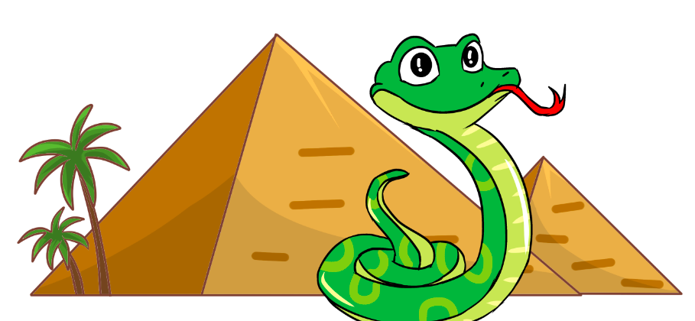
1. Project Overview
main.py
snakeclass.py
files (folder)

Slide 3
1. main.py
import pygame
from snakeclass import *
pygame.init()
pygame.mixer.init()
screen = pygame.display.set_mode((900, 600))
pygame.display.set_caption('Greedy Snake')
show_start(screen)
food_score, time_score = main_loop(screen)
show_end(screen, food_score, time_score)
show_top10(screen, food_score+time_score)

Slide 4
2. snakeclass.py
import pygame, os, sys, time
from pygame.locals import *
import random
import files.pygame_textinput as pygame_textinput
FILE_PATH = os.path.join(os.path.dirname(__file__), 'files')
os.chdir(FILE_PATH)
font = pygame.font.Font(None, 30)
class Snake(pygame.sprite.Sprite):
…
class Raspberry(pygame.sprite.Sprite):
…
def show_start(screen):
…
def main_loop(screen):
…
def show_end(screen, food_score=0, time_score=0):
…
def show_top10(screen, score):
…
def input_name(screen):
…

